Slide 1
Execution models for distributed computing
CS460 Systems for Data Management and Data Science
Prof. Anastasia Ailamaki
Data-Intensive Applications and Systems (DIAS) Lab

Slide 2
Last week: distributed transactions
Data science software stack
Data Processing
Transaction
Management
Graph Data
Pregel, GraphLab, X-Streem, Chaos
Structured Data
Spark SQL
Machine Learning
Gossip Protocols
Query Execution
Batch Data
Map Reduce, Dryad, Spark
Streaming Data
Storm, Naiad, Flink, Spark Streaming Google Data Flow
Consistency protocols
CAP Theorem
Data Storage
Storage Hierarchies & Layouts
Distributed File Systems
(GFS)
NoSQL DB
Dynamo
Big Table Cassandra
Distributed Messging systems
Kafka
Distributed/Decentralized systems
Resource Management & Optimization
Query optimization
Scheduling (Mesos, YARN)
Notes:
With Orange, we denote more general topics that are applied across several systems and architectures, both in scale-up and scale-out deployments.

Slide 3
Refresher: 2 phase commit (success)
(coordinator) T1,1
T1,2
T1,3 (subordinates)
prepare to commit
Y
Y
commit
time
ACK
ACK

Slide 4
2 phase commit (failure)
(coordinator) T1,1
T1,2
T1,3 (subordinates)
prepare to commit
Y
N
abort
time
ACK
ACK

Slide 5
2PC (with presumed commit)
(coordinator) T1,1
T1,2
T1,3 (subordinates, NOT read only)
prepare to commit
prepare*
prepare*
Y
Y
commit*
commit
Record subs names in log rec.
Remove T1 from Xact table
commit
ACKs and end log are eliminated.
Commit logs are not forced on subs.
commit
time

Slide 6
2PC (with presumed abort)
(coordinator) T1,1
T1,2
T1,3 (subordinates, NOT read only)
prepare to commit
prepare*
abort
Y
N
ACKs, and end log are eliminated.
Abort logs are not forced.
abort
NO subs names in log rec.
Remove T1 from Xact table
abort
abort
time

Slide 7
Leftover from last week: replication!
Parallel architectures
Data partitioning
Distributed transactions
Concurrency control
Commit
Replication

Slide 8
Server failures carry significant overhead
Servers continuously fail in large-scale systems
Wait for recovery: too long…
Use replication!
Keep several copies the data, i.e., replica, in other servers
If a server fails, another server takes over
Also use for load balancing
Up to now: strong consistency
All copies have to have the same value
“Customer of online services will be confronted with the consequences of using replication techniques”
Notes:
One of the key issues with distributed databases is that of server failures. In large scale systems the probability of any one machine failing is very high. Waiting for recovery may not be desirable as it may take too long.
To mitigate failures data can be replicate across servers and if a server fails a server with the data replica can take over it. Such replicas are also useful in balancing load since a transaction can read from either replica.
So far we have assumed that all replicas have the same value which provides strong consistency guarantees to transactions.

Slide 9
Replication & Updating Distributed Data
Synchronous Replication: All copies of a modified relation (fragment) must be updated before the modifying Xact commits.
Data distribution is made transparent to users.
Asynchronous Replication: Copies of a modified relation are only periodically updated; different copies may get out of sync in the meantime.
Users must be aware of data distribution.
Notes:
When using data replication across servers we need to modify all replicas of the data in case of updates. There are 2 ways of doing this
Synchronous replication – update all copies before commit – can read from any replica hence the data distribution is transparent to users
Asynchronous replication – modify only local copy, other copies may be updates periodically – users need to be aware of how the data is distributed – read from replicas may not be identical

Slide 10
Synchronous Replication
Voting: Xact must write a majority of copies to modify an object; must read enough copies to be sure of seeing at least one most recent copy.
E.g., 10 copies; 7 written for update; 4 copies read.
Each copy has version number.
Not attractive usually because reads are common.
Read-any Write-all: Writes are slower and reads are faster, relative to Voting.
Most common approach to synchronous replication.
Choice of technique determines which locks to set.
Notes:
Transaction writes: Majority of copies
Transaction read: Enough copies to ensure at least one most recent copy is read
Let us consider an example where the data has 10 replicas. If the transaction can commit only after writing to 7 replicas, reading from 4 replicas is enough to ensure that each update is read
Since reads are more common is most applications, the most common approach to synchronization is to commit only after all replicas have been written to, Any one replica can be read for reads.

Slide 11
Cost of Synchronous Replication
Before an update Xact can commit, it must obtain locks on all modified copies.
Sends lock requests to remote sites, and while waiting for the response, holds on to other locks!
If sites or links fail, Xact cannot commit until they are back up.
Even if there is no failure, committing must follow an expensive commit protocol with many msgs.
So the alternative of asynchronous replication is widely used in NoSQL systems (a.k.a eventual consistency)
Notes:
Synchronous replication has high overheads. In order to commit a transaction locks must be obtained on all modified copies of the data. Locks must be held till all replicas have responded. Commit protocol has to maintain messages of all replicas and hence it is expensive.
An alterative is the asynchronous replication that is used in NoSQL systems

Slide 12
Asynchronous Replication
Allows modifying Xact to commit before all copies have been changed (and readers nonetheless look at just one copy).
Users must be aware of which copy they are reading, and that copies may be out-of-sync for short periods of time.
Two approaches: Primary Site and Peer-to-Peer replication.
Difference lies in how many copies are ``updatable’’ or ``master copies’’.
Notes:
In asynchronous systems transaction can commit without waiting for writes on all copies while being able to read from one copy
Users need to be aware of the copy that they are reading from
Asynchronous techniques are used for propagating changes from one copy to another, rather than synchronizing them in the context of distributed transactions. Two replication schemes are used: Primary site and symmetric replication (peer to peer).

Slide 13
Primary Site Replication
Exactly one copy of a relation is designated the primary or master copy. Replicas at other sites cannot be directly updated.
The primary copy is published.
Other sites subscribe to (fragments of) this relation; these are secondary copies.
Main issue: How are changes to the primary copy propagated to the secondary copies?
Done in two steps. First, capture changes made by committed Xacts; then apply these changes.
Notes:
In Primary site replication one copy is designated as the primary/master copy and other copies replicate this copy.
All changes are performed on the primary copy, while the secondary copy is asynchronously updated by the replication manager and is read-only for all applications. Changes to the primary copy are first monitored by a capture module installed at the primary copy site and then propagated to the copy by an apply module installed on the sites storing the secondary copies. Secondary copies can only be updated with updates from the primary.
To propagate updates of primary to secondary the changes mad by transactions are captured and then applied to secondary copies.

Slide 14
Implementing the Capture Step
(Physical) Log-Based Capture: The log (kept for recovery) is used to generate a Change Data Table (CDT).
If this is done when the log tail is written to disk, must somehow remove changes due to subsequently aborted Xacts.
Procedural Capture: A procedure that is automatically invoked (ex: trigger) does the capture; typically, just takes a snapshot.
Log-Based Capture is cheaper & faster, but relies on proprietary log details.
Middle-ground: Logical log-based capture
[MySQL] Row-based replication: Describe edits at row granularity
Notes:
In order to capture the changes made to the primary site a log based capture or procedural captures could be used
In physical log based capture, the log for recovery is used to create a change data table. We need to remove changes to the CDT caused by aborted transactions.
In procedural capture, a procedure responsible for the replication is automatically invoked
Physical log based capture -> cheaper and faster since no triggers are involved but uses proprietary log details
Logical log based capture provides a middle ground. In MySQL row based replication is used which describes the updates at row level graunularity

Slide 15
Implementing the Apply Step
The Apply process at the secondary site periodically obtains (a snapshot or) changes to the CDT table from the primary site, and updates the copy.
Period can be timer-based or user/application defined.
Replica can be a view over the modified relation!
If so, the replication consists of incrementally updating the materialized view as the relation changes.
Log-Based Capture plus continuous Apply minimizes delay in propagating changes.
Procedural Capture plus application-driven Apply is the most flexible way to process changes.
Notes:
The changes captured at the primary needs to be applied to the secondary sites.
The secondary periodically obtains the changes and applies the updates.
Replicas can be treated as materialized views and the techniques of view maintenance can be applied.
Log based capture with continuous apply minimizes delay is update propagation while procedural capture and application driven apply is more flexible

Slide 16
Peer-to-Peer (multi-leader) Replication
More than one of the copies of an object can be a master in this approach.
Changes to a master copy must be propagated to other copies somehow.
If two master copies are changed in a conflicting manner, this must be resolved. (e.g., Site 1: Joe’s age changed to 35; Site 2: to 36)
Best used when conflicts do not arise:
E.g., Each master site owns a disjoint fragment.
E.g., Updating rights owned by one master at a time.
Notes:
In P2P replication more than one copy can be the master copy. Changes to one copy need to be propagated to others like in case of primary site replication but since more than one master copy is present there could be conflicts (from updates to different master copes) that need to be resolved.
Conflicts can be avoided in P2P replication by either having each site master of one disjoint fragment/partition of data or by making one site the master at a time

Slide 17
Register for Midterm
Fill in the midterm attendance poll on Moodle before 21/3
https://moodle.epfl.ch/mod/choice/view.php?id=1326463
Please respond even if you are not planning to attend
We will only use responses to book the correct number of rooms

Slide 18
Today: dataflow and Spark
Data science software stack
Data Processing
Transaction
Management
Graph Data
Pregel, GraphLab, X-Streem, Chaos
Structured Data
Spark SQL
Machine Learning
Gossip Protocols
Query Execution
Batch Data
Map Reduce, Dryad, Spark
Streaming Data
Storm, Naiad, Flink, Spark Streaming Google Data Flow
Consistency protocols
CAP Theorem
Data Storage
Storage Hierarchies & Layouts
Distributed File Systems
(GFS)
NoSQL DB
Dynamo
Big Table Cassandra
Distributed Messging systems
Kafka
Distributed/Decentralized systems
Ressource Management & Optimization
Query optimization
Scheduling (Mesos, YARN)
Notes:
With Orange, we denote more general topics that are applied across several systems and architectures, both in scale-up and scale-out deployments.

Slide 19
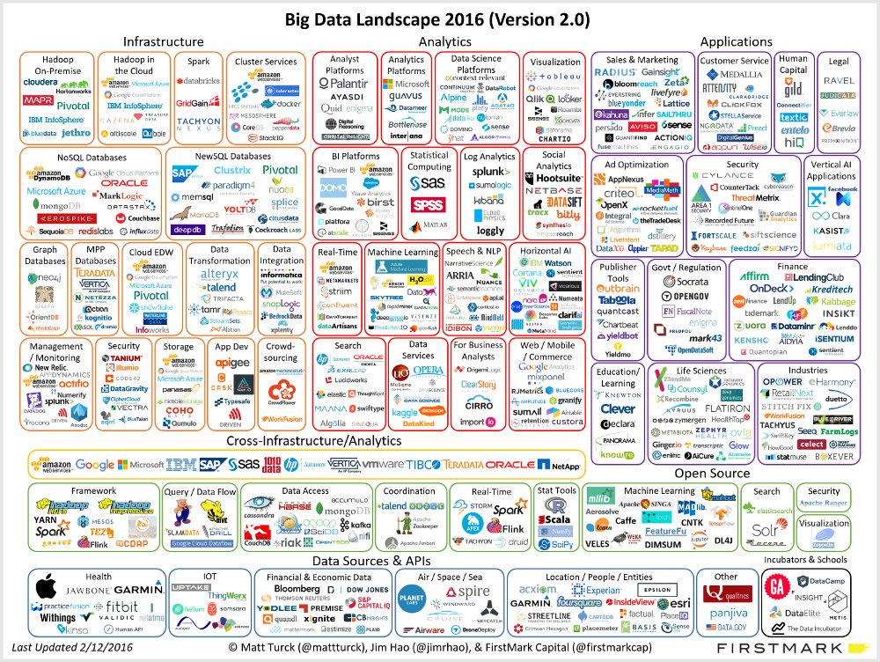
Notes:
The big data landscape is extremely rich and complex. We have Infrastructure, Analytics, and Applications built on top. The boundaries are fuzzy!
Infrastructure includes popular systems such as hadoop, spark, mapreduce. These are systems built specifically for making management and processing possible, cheap, and efficient.
Analytics include platforms built to ease extraction of useful knowledge and insights out of big data. These may operate over an established infrastructure layer, e.g. spark.
Applications include solutions developed for particular use cases or domains.
Many solutions are cross-infrastructure/analytics, so we can mix and match different systems to best serve our use case!

Slide 20
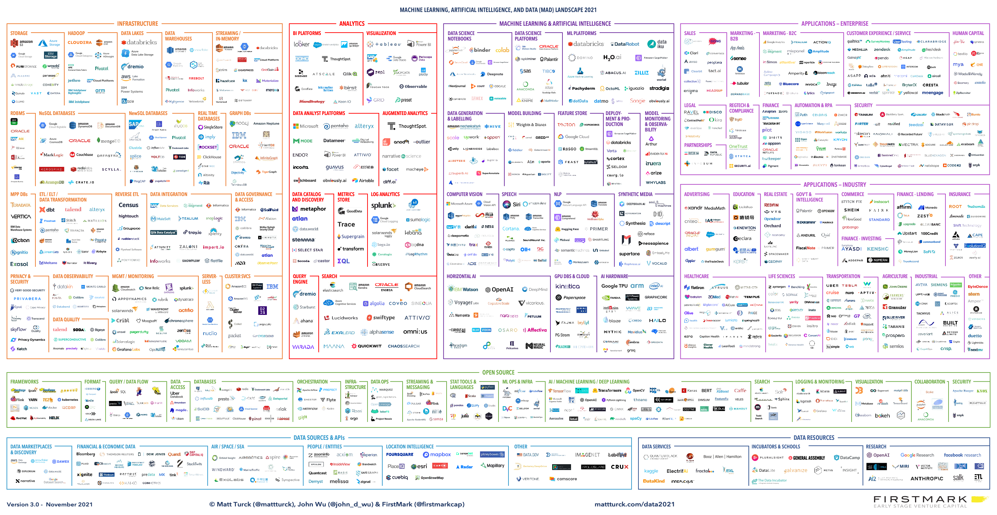
Big Data Landscape (2021)

Slide 21
Data Processing at Scale
Distribute computations across 1000s nodes
Parallelization is necessary for timely responses
Hide complexity of distributed execution
Framework needs to provide partitioning, FT, scheduling
Process more diverse and complex computations
Programming model needs the right abstractions
Notes:
Now, let’s see how Big Data systems address the challenges of the Big Data era:
- First, they focus on distributed computations. Processing large data volumes cannot be fast enough with sequential processing. Thus, they use 1000s of nodes to parallelize computations and brings down response times.
-Second, they hide complexity of distributed execution. Distributed execution requires functionality such as partitioning, fault-tolerance, scheduling and deployment to take place. However, having application programmers handle this is time-consuming and error-prone, and results in much more complex programs. So, Big Data systems provide this functionality through frameworks
-Third, computations are more diverse and complex. Traditional SQL is not sufficient any more as it cannot easily cover the required use cases. Distributed computing needs programming models with the right abstractions, and which permit both expressiveness and performance.

Slide 22
Overview
Distributed Query Processing
MapReduce model
Dataflow model in Spark
Optimizing Large-scale Processing
Notes:
In this lecture, we focus on the programming models and show how they translate to distributed execution. We start by presenting historical distributed query processing on SQL engines. Then, we present the MapReduce model which is a functional way to express more diverse large-scale computation. We continue our presentation with the dataflow model used in Spark, which further improves expressivity for a wide range of applications such as iterative algorithms. Finally, we loop back to a SQL-like interface, Dataframe, which brings the benefit of being optimizable to expressive models such as dataflow.

Slide 23
Overview
Distributed Query Processing
MapReduce model
Dataflow model in Spark
Optimizing Large-scale Processing
Notes:
First, we are going to talk about distributed SQL execution. Here we will talk about two topics: declustering aka partitioning and processing techniques for parallel operators

Slide 24
Distributed Joins
To join tables R and S, the DBMS needs to get the proper tuples on the same node.
Once the data is at the node, the DBMS then executes standard join algorithms locally

Slide 25
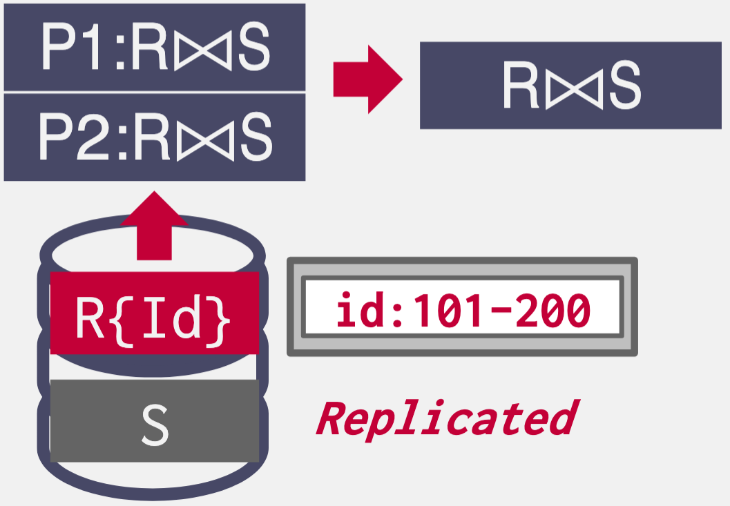
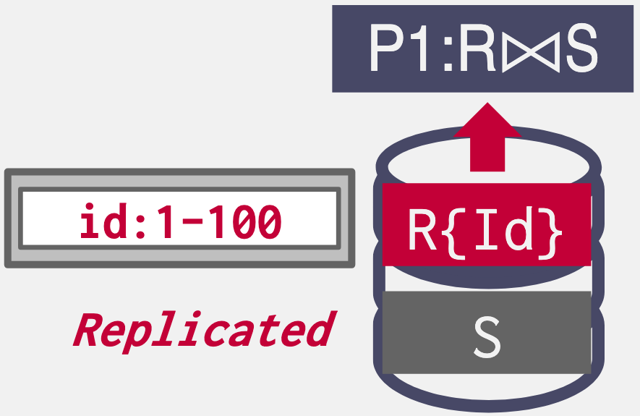
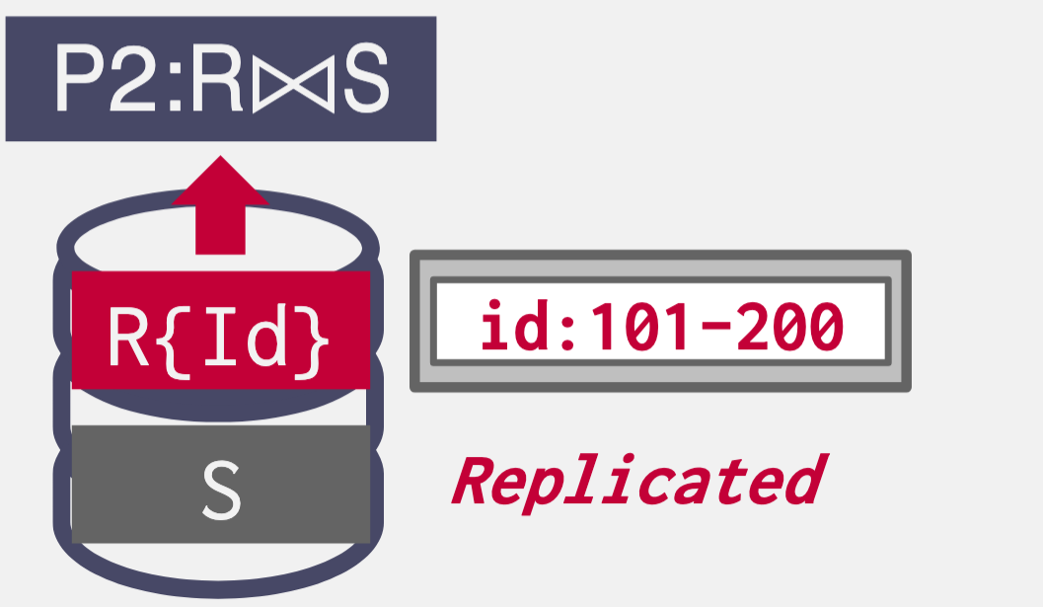

Distributed Join: Scenario #1
One table is replicated at every node.
Each node joins its local data in parallel and then sends their results to a coordinating node.
SELECT * FROM R JOIN S
ON R.id = S.id

Slide 26
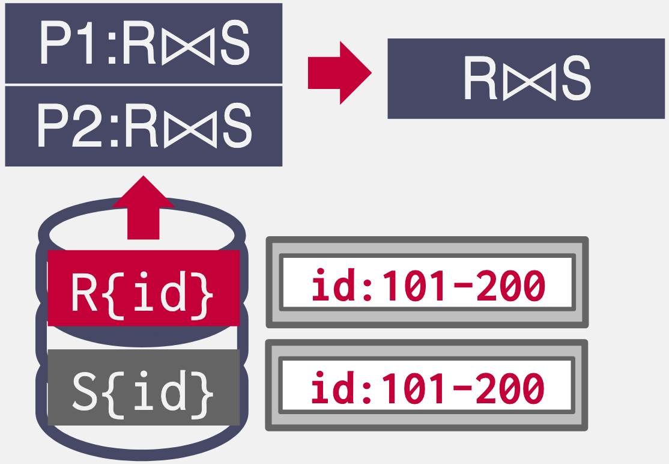
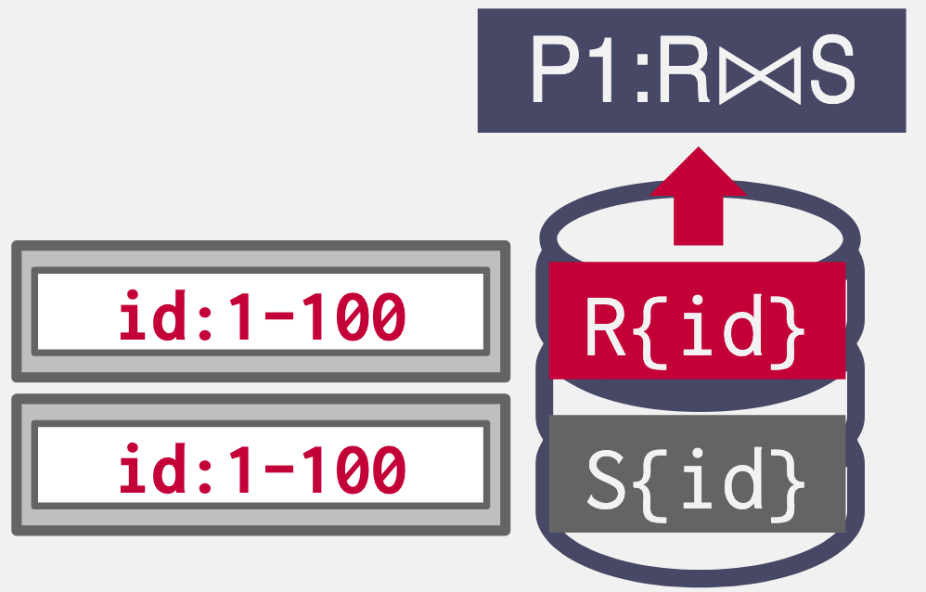
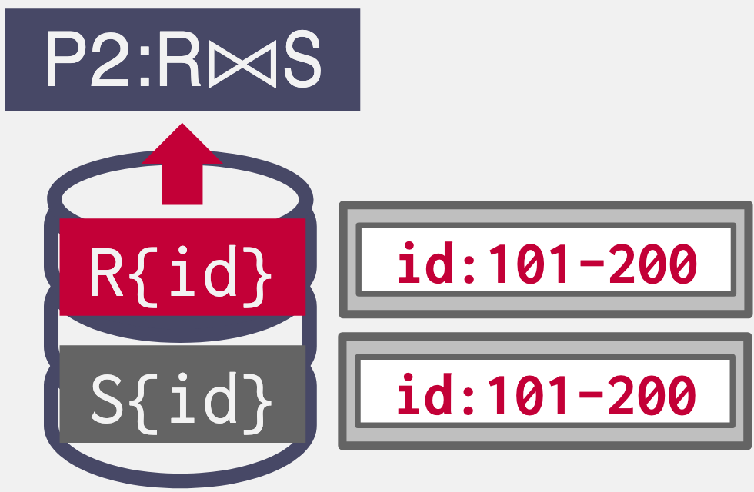
Distributed Join: Scenario #2
Tables are partitioned on the join attribute.
Each node performs the join on local data and then sends to a coordinator node for coalescing.
SELECT * FROM R JOIN S
ON R.id = S.id

Slide 27
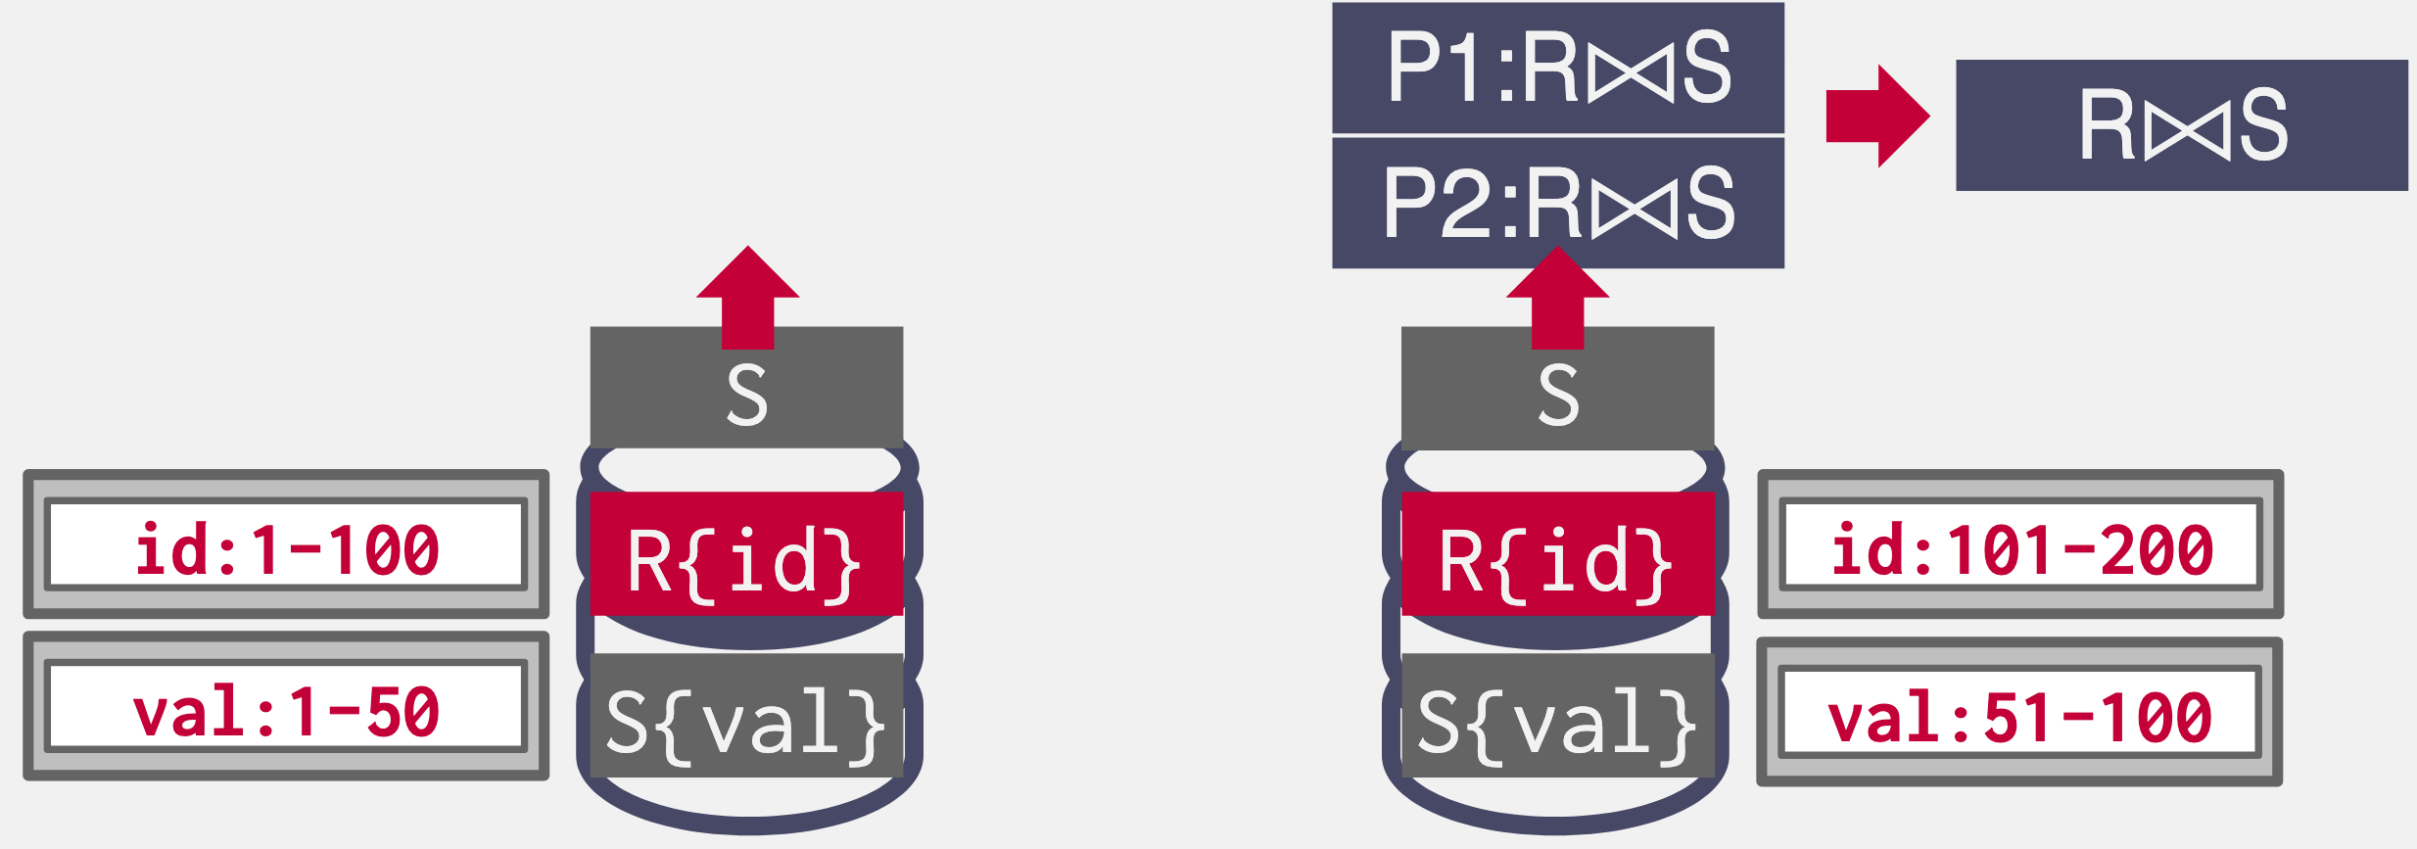
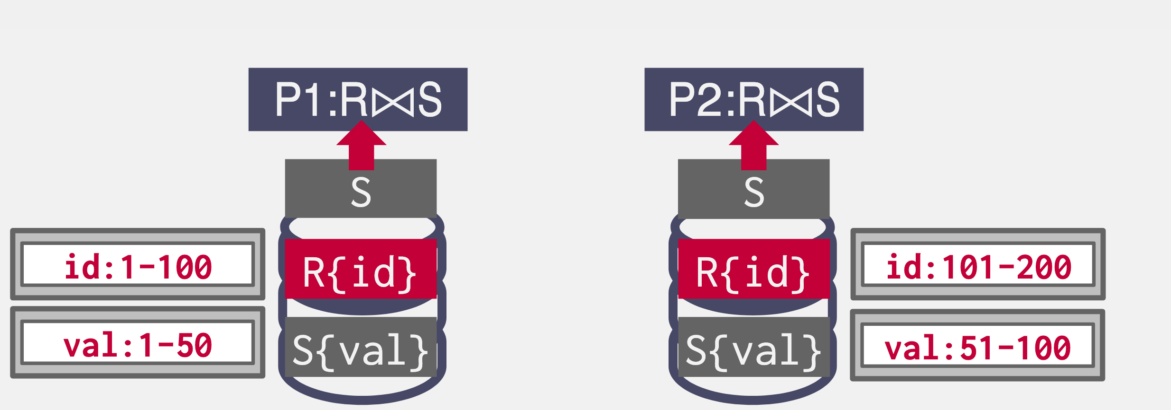
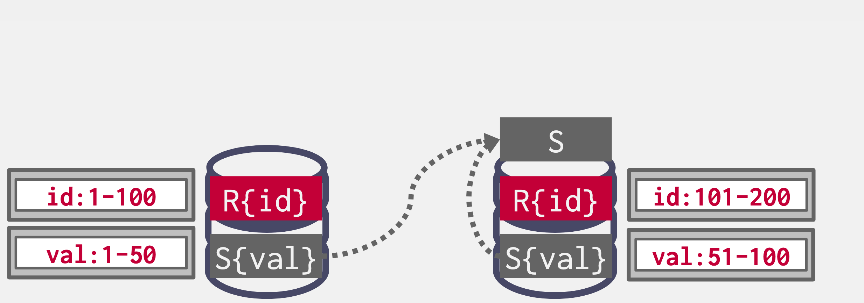
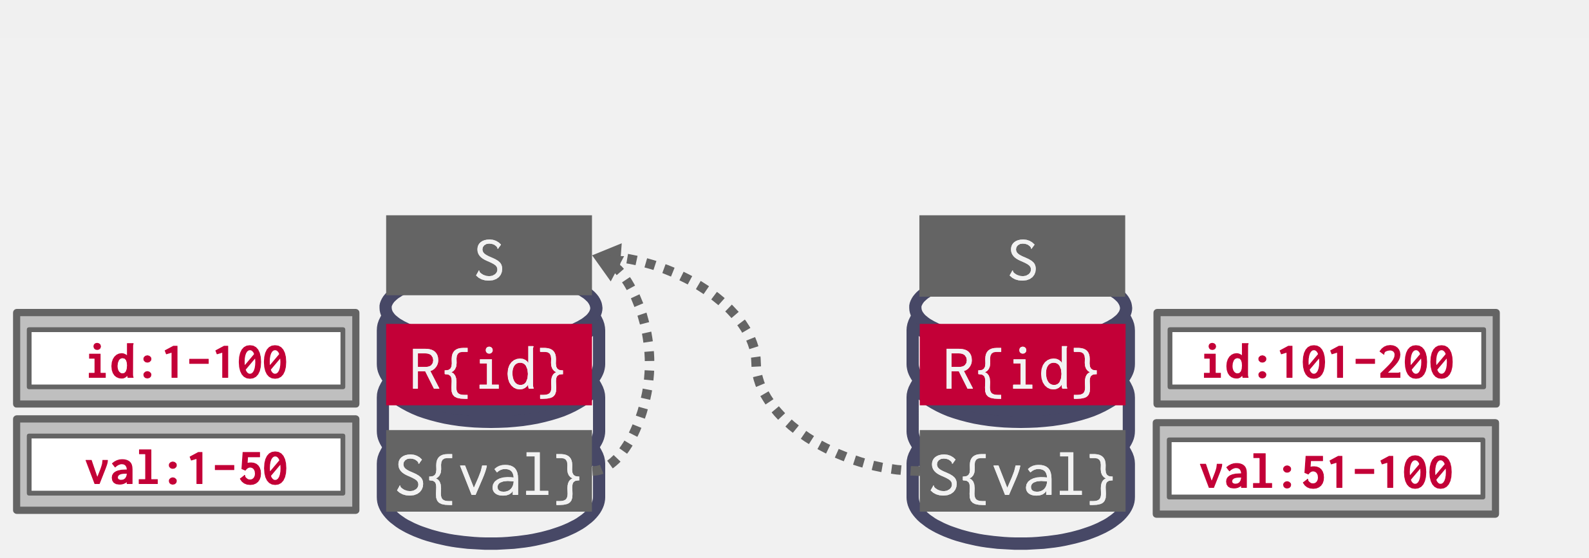
Distributed Join: Scenario #3 – Broadcast Join
Both tables are partitioned on different keys.
If one of the tables is small, then the DBMS "broadcasts" that table to all nodes.
SELECT * FROM R JOIN S
ON R.id = S.id

Slide 28
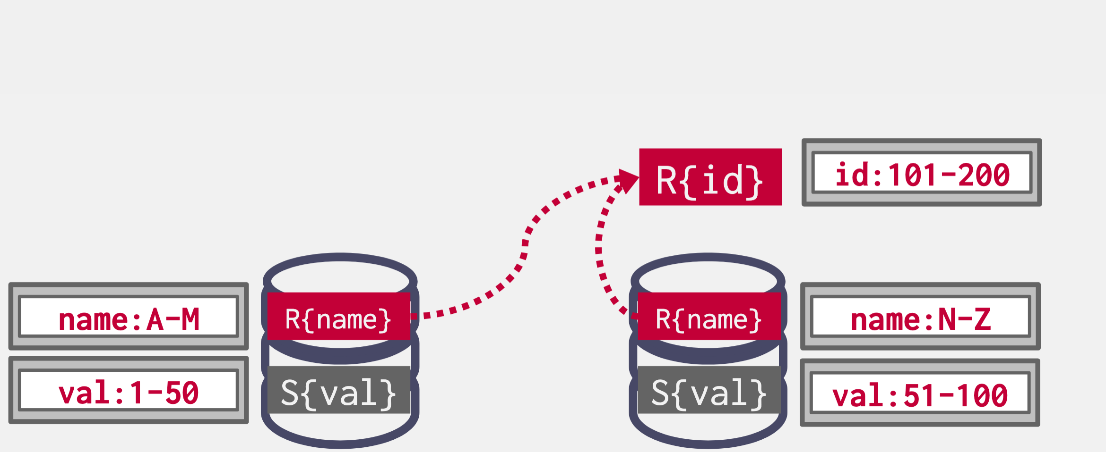
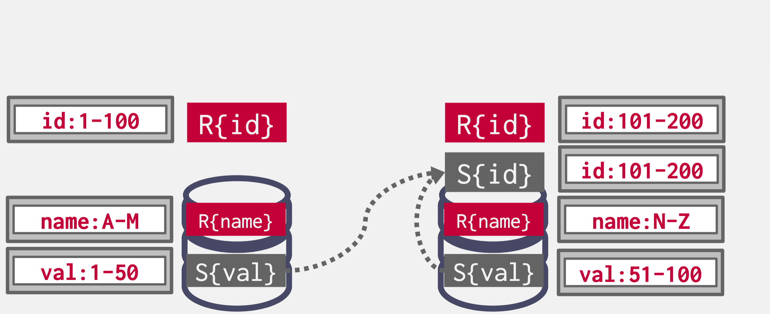
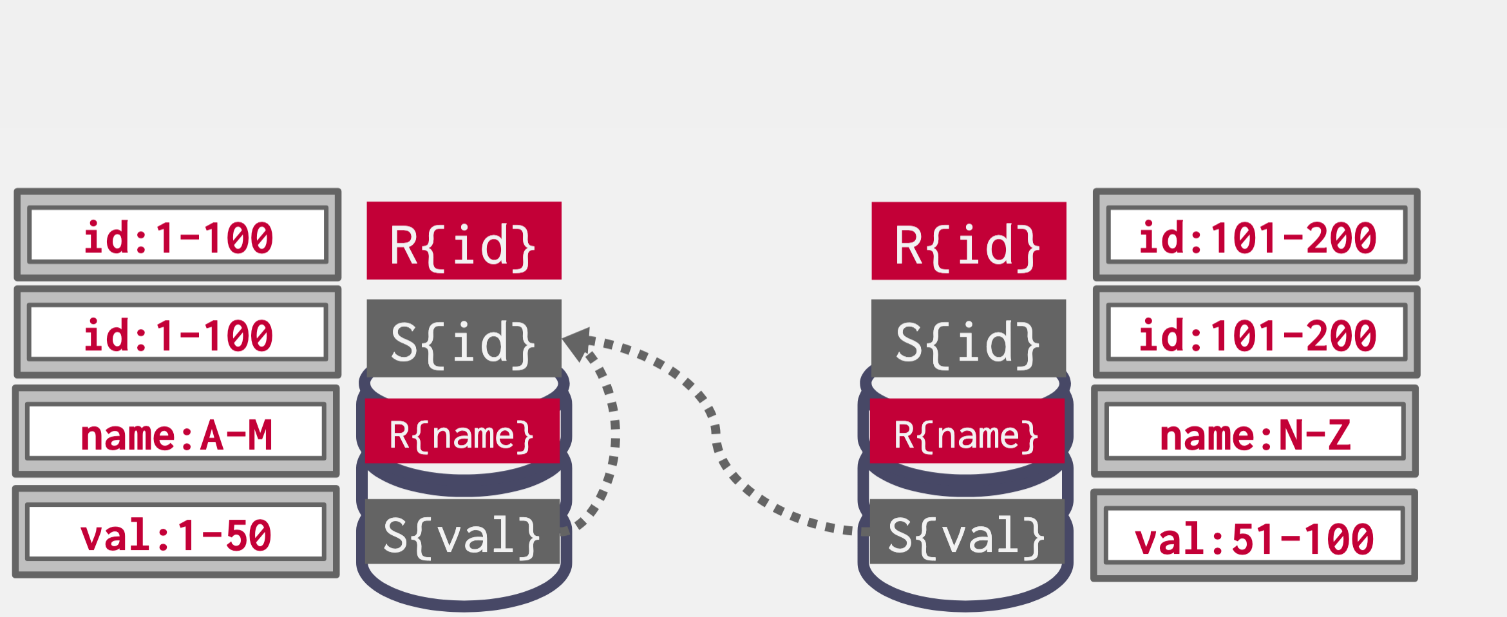
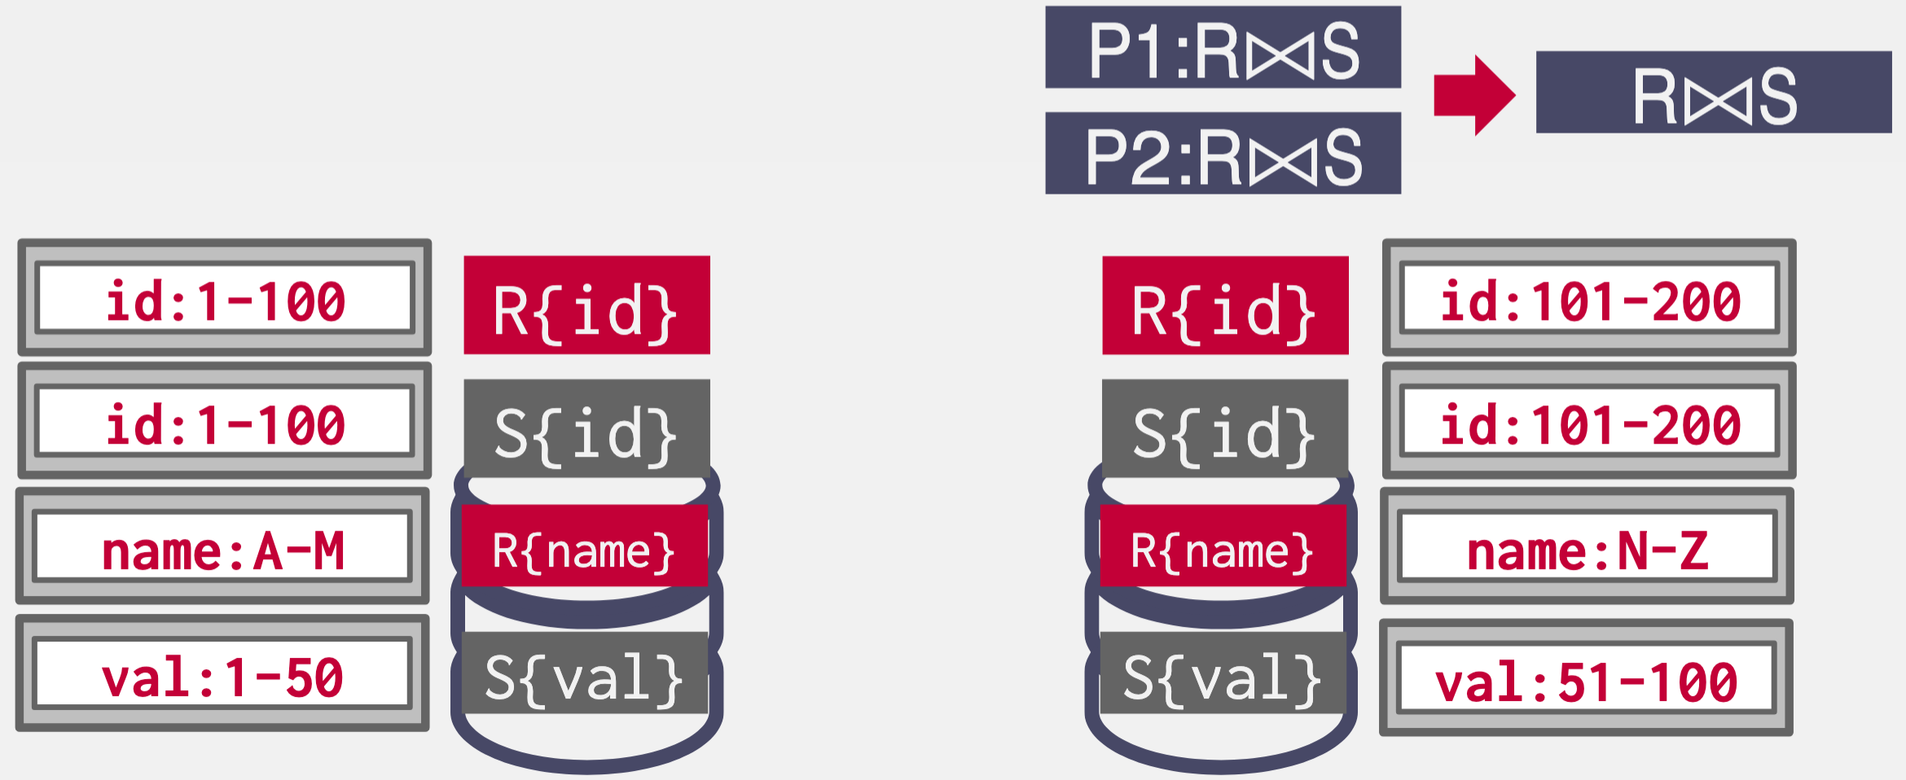
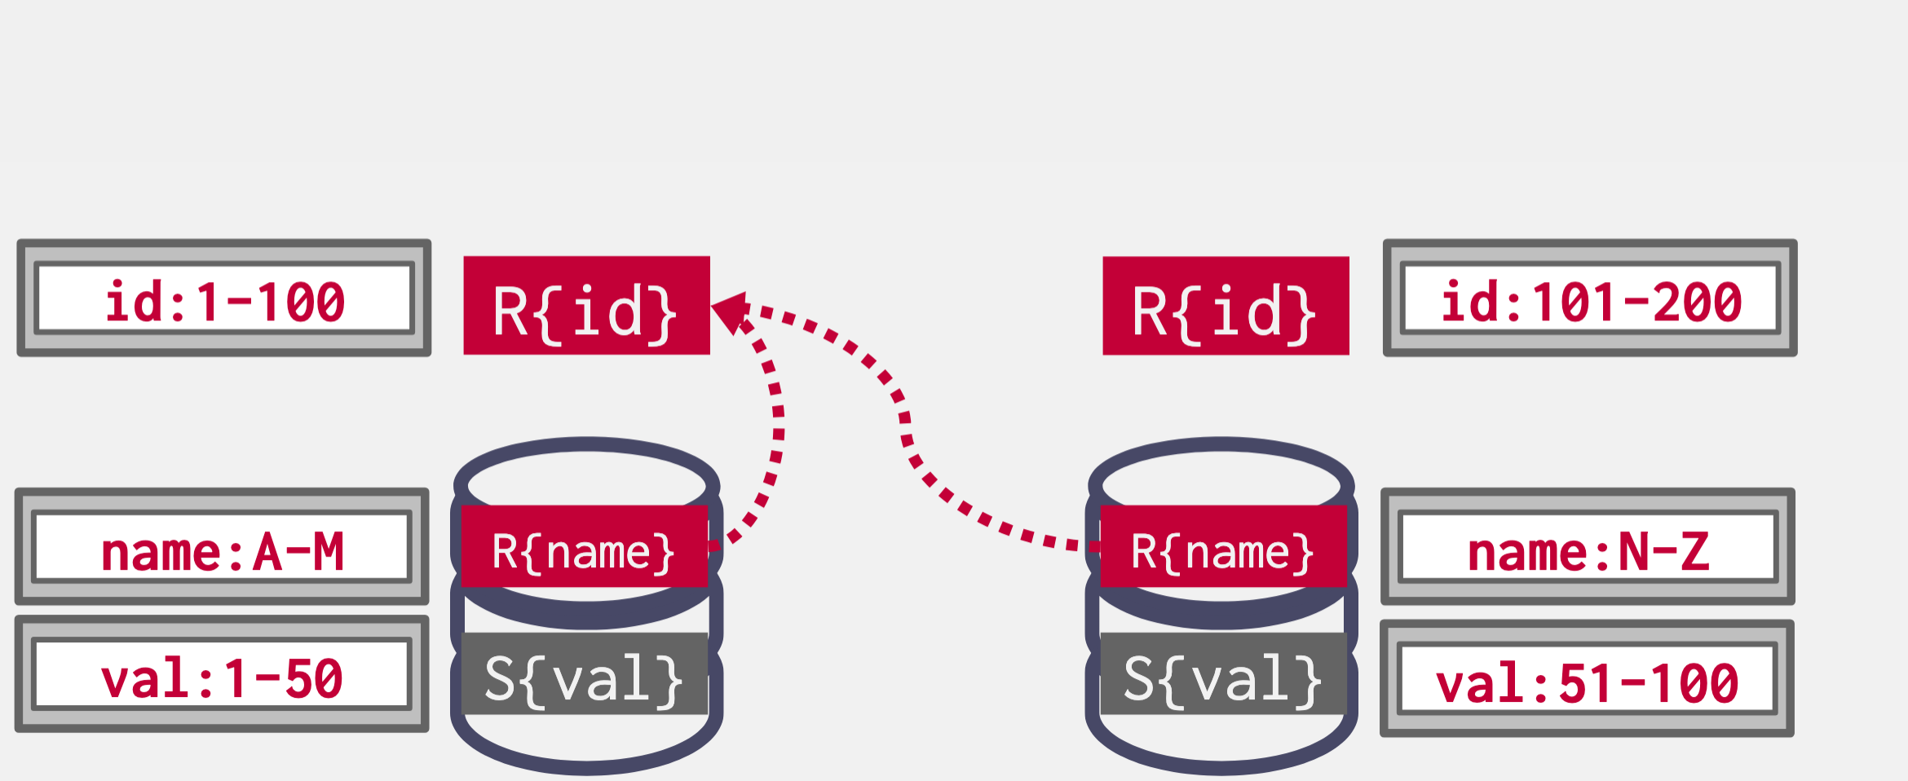
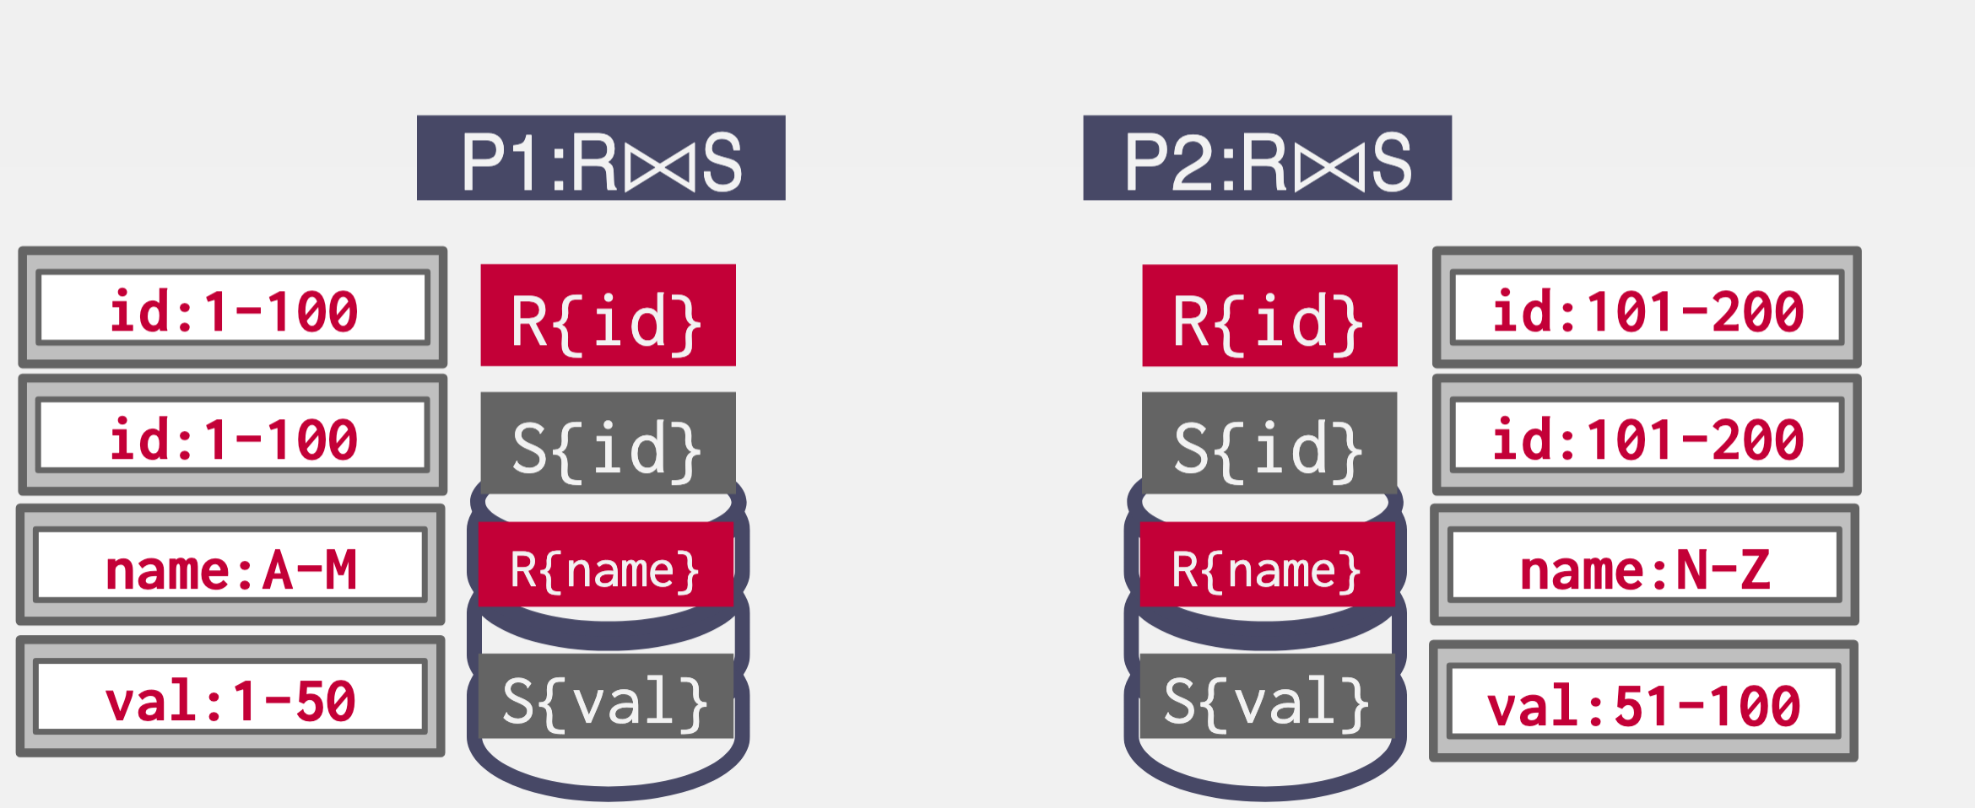
Distributed Join: Scenario #4 – Shuffle Join
Both tables are not partitioned on the join key. The DBMS copies the tables by "shuffling" them across nodes.
SELECT * FROM R JOIN S
ON R.id = S.id

Slide 29
Summary
Distributed query execution is built on top of partitioning
Shuffling data is slow
Essential to match the partitioning scheme to expected workload

Slide 30
Overview
Distributed Query Processing
MapReduce model
Programming model
Under the hood
Dataflow model in Spark
Optimizing Large-scale Processing

Slide 31
Programming models for Big Data
Big data is a game changer
large amounts of raw data
diverse (non-relational) computations e.g. summaries, inverted indices, different representations
requires parallelizing over 1000s nodes for timely responses
Distributed computation is usually simple but requires complex code to handle distribution, FT, scheduling, partitioning
The MapReduce approach: code using functional model, hide complexity behind a library
Notes:
With big data, we have a departure for previous applications, where SQL processing with Gamma was sufficient:
now we have large amounts of raw data which do not necessarily fit in the relational table model
our computations are also often non-relational, e.g. it can be summarizing large amounts of data, computing inverted indices, transforming to different representations, graph algortihms, etc
finally, we may now have to parallelize over 1000s of nodes to get timely responses, which exposes several challenges. For example,fault tolerance is much more important because it is the rule, not the exception.
The computation itself is not really the source of complexity. In fact, the computation is often very simple. However, even for the simplest computation, a lot of complexity is required for distribution, FT, scheduling, partitioning
MapReduce steps in exactly for this use case. It offers a functional interface where users can write their custom code to handle diverse data and computations, while hiding complexity behind a library.

Slide 32
The vision…
Sample function: convert all text to upper case
Splits may be
stored at diff. nodes
Huge
data
file
split 1
Map
out 1
Result
split 2
Map
out 2
U
split 3
Map
out 3
split 4
Map
out 4
split 5
Map
out 5
Notes:
Let’s see how MapReduce’s model works in action. Suppose that we want to perform a very simple operation e.g. convert all text to upper case
We consider the file split in several parts. The parts can be stored at different nodes, in a distributed file system.
The user uploads their code in the map function. The map function is applied over each split to produce a partial result. Splits are distributed over the nodes, and the map function is, by requirement, a local function that can be executed individually at each node. So, the map is naturally parallelized across nodes, even though the user didn’t have to explicitly implement parallelization.
At the end, union or concatenation of the partial results in the right order to produce the full result.

Slide 33
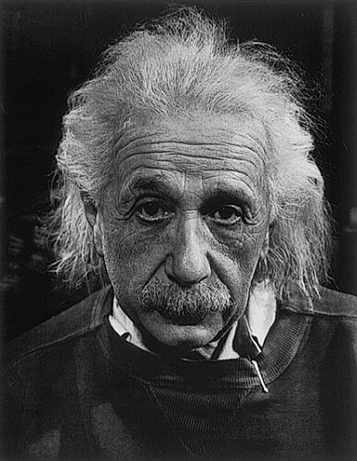
The vision (2)
More complicated: the word-count problem
Huge file: extract frequencies of words
Example
Extracted frequencies:
<Logic,1>, <will,2>, <get,1>, <you,2>, …
Logic will get you from A to B.
Imagination will take you everywhere.
Einstein once
said…
Notes:
A more complicated example is the word-count. Here, we want to take big chunks of text and calculate the frequency of each word in the text. For instance, for the phrase on the slide, we get the extracted frequencies shown.
Consider the quote from Einstein “Logic will get you from A to B. Imagination will take you everywhere.“, then the result is the frequencies <Logic,1>, <will,2>, <get,1>, <you,2>, …
This example is more complicated because it requires a clever merging of the results, even across nodes.

Slide 34
The vision (3)
Sample application: the word-count example
(logic, 1)
(will, 1)
(get, 1)
Logic will get
(logic, [1])
(will, [1, 1])
(from, [1])
(logic, 1)
(will, 2)
(from, 1)
Huge
data
file
split 1
Map
Result
Map
Reduce
out 1
split 2
Reduce
out 2
U
split 3
Map
Repeated
for all
Reduce
out 3
split 4
Map
split 5
Map
Merging of
results
grouped by word
Local
computation
Notes:
MapReduce enables us to define two phases:
- a Map phase, which will do the local computation
- a Reduce phase, which will be responsible for the merging of the partial results.
In this example, Map is not sufficient because we need to merge frequencies across nodes, and this is where Reduce comes in. Reduce processes (key, value) pairs. It brings together pairs with the same key and then merges their result in a custom computation.
In this example, local computation will be a word count for each split, or just emitting 1 message for each word observed in the split. Every time I see a word, I just send a message to a reducer saying that I just saw this word.
Reduce: Merging of local computation results, i.e., summing up!

Slide 35
MapReduce programming model
Data model: everything is a <key,value> pair
Map(key, value) function
Reduce(key, list(values))
The system parallelizes and deploys user’s code
(key, value)
list((key, value))
value is split
key often unused
(key, list(values))
(key, value)
list of all values emitted
by ALL mappers for key
Notes:
To formalize MapReduce, it abstracts processing as computations over (key,value) pairs
Map invoked for every key, value pair in input. Frequently, only values are interesting for map, e.g., when processing large text files, values are the lines that occur in the file.
Reduce invoked for every unique key emitted by map, second parameter is list of values that were emitted by map for this particular key across all nodes. Reduces merges the list of values to compute a new value
The functions are parallelism and deployment oblivious. The system takes the user’s code and deploys it.

Slide 36
Overview
Distributed Query Processing
MapReduce model
Programming model
Under the hood
Dataflow model in Spark
Optimizing Large-scale Processing

Slide 37
MapReduce – under the hood
Shuffle phase
Map
phase
Sort Send Merge
Reduce
phase
DFS
DFS
<Logic,1>
<Logic,{1}>
<Logic,1>
Input data
Reduce
Split
Map
<will,1>
<will,{1,1}>
<will,2>
<get,1>
…
…
…
Split
Map
<Imagi…,1>
<get,{1}>
<get,1>
Reduce
<will,1>
<Imag..,{1}>
<Imagi…,1>
<take,1>
<take,{1}>
<take,1>
…
…
…
Intermediary results are saved as
regular files in DFS. Is this good?
for each word in value
emit pair <word,+1>
for each value in list(values)
count+=value
emit pair<word,count>
37
Notes:
MapReduce execution engine identifies three phases: The Map phase, the Reduce phase, and the shuffle phase that occurs in between the two.
First, data is partitioned to smaller splits written in a DFS (Distributed File System).
Then, map phase executed per split, individually at each node. will produce a set of [key, value] pairs.
Then, shuffle phase will sort these pairs, and hash them based on their key, and send them to another node. All <K,V> pairs with the same key will end up in the same node and will be merged in a list.
Then reduce phase will get the lists created for each key. In our example, reduce was a single count of the list elements. Results will be written in DFS again.
Important to understand that in standard MapReduce, all these messages are actually translated to IO writes (file appends) in the DFS.

Slide 38
MapReduce – under the hood (2)
Shuffling consumes network and causes delays
Idle time for CPUs
Progressive shuffling
Phases partially overlap: reducers start before maps fully complete
Node 1
Map
Reduce
Node 2
Map
Reduce
Node 3
Map
Reduce
Time
Is it possible that a reducer has to wait for mappers/shuffling before it continues?
Notes:
Even though in the previous figure we displayed Map, reduce and shuffle as distinct phases, in practice these have a small overlap. Why is that?
Actually, we do not need all the results from the Map phase, before we starting reducing them.
For this reason, many times it’s better to overlap Map with Reduce, as this way our execution becomes more efficient and we can cover overheads coming from the network or the disk I/O.
If the logic of the reducer is less complicated than the logic of the mapper, then it can happen that the reducer finishes earlier. Then, it should wait for more input to come in.

Slide 39
Problems with MapReduce
Performance: Extensive I/O
Everything is a file stored in hard disk, no distributed memory
Programming model: Limited expressiveness
E.g., iterations, cyclic processes
Procedural code in map and reduce, difficult to optimize
MapReduce is a major step backwards
DeWitt and Stonebraker, 2008
Notes:
- The main problem with MapReduce is that it requires extensive I/O. Specifically, to execute a task, we usually require a set of MR jobs where each job stores intermediate results in HDFS. By storing into the hard disk after each operation we have a significant slowdown in performance.
Another issue of MapReduce is the programming model. The programming model trades simplicity for expressiveness, since there is not a unified way to express complicated operations that are required in large scale data analytics that the framework is anyway designed for. Therefore, for more complex operations, users have to implement them manually by expressing them using Map and Reduce operations which might involve multiple iterations. Therefore, it is difficult to optimize the operation.
According to DeWitt and Stonebraker, MapReduce may be a good idea for writing certain types of general-purpose computations, but to the database community, it is: A giant step backward in the programming paradigm for large-scale data intensive applications
A sub-optimal implementation, in that it uses brute force instead of indexing
Not novel at all -- it represents a specific implementation of well known techniques developed nearly 25 years ago
Missing most of the features that are routinely included in current DBMS
Incompatible with all of the tools DBMS users have come to depend on
MapReduce uses coarse-grained tasks to do its work, which are too heavyweight for iterative algorithms. Another problem is that MapReduce has no awareness of the total pipeline of Map plus Reduce steps, so it can’t cache intermediate data in memory for faster performance. Instead, it flushes intermediate data to disk between each step. Combined, these sources of overhead make algorithms requiring many fast steps unacceptably slow.
For example, many machine learning algorithms work iteratively. Training a recommendation engine or neural networks and finding natural clusters in data work intuitively like this: you “guess” an answer to a set of equations representing your model, you measure the error, and then adjust the trial answer in a way that reduces the error. Wash, rinse, repeat until your guess produces small enough errors that your answer is good enough.
Another use for iterative algorithms is graph analysis. For example, Twitter and other social networks have data about the links between you, your connections, their connections, and so forth. That data is nicely modeled as a graph. Most graph algorithms traverse the graph one connection per iteration.
Obviously, you want the steps in these kinds of algorithms to be as fast and lightweight as possible.
The problem is escalated by the growing need to get answers faster, where previously a batch approach was considered good enough, but now a streaming approach that extracts information from data more quickly is a competitive advantage. Updating search engine data was traditionally done with periodic batch runs. It used to be fine if you updated your web pages today and those changes showed up in search engines tomorrow or so. Today, the competitive advantage lies in search engines that reflect the changing Internet as quickly as those changes are detected by web crawlers. For example, if a user searches for information about a news event, you would like your search engine to take that user to the latest information available.
Until now, developers uses various MapReduce hacks or alternative tools to support these needs, but clearly there is a need for a better computation engine that supports these algorithms directly, while continuing to support more traditional batch processing of large datasets.

Slide 40
Summary
MapReduce empowers user to distribute custom code for variety of data and computations
Framework hides complex functionality behind libraries
Abstractions hurt performance and limit expressiveness

Slide 41
Overview
Distributed Query Processing
MapReduce model
Dataflow model in Spark
Optimizing Large-scale Processing

Slide 42


The data flow model
Construction goals
Improve expressiveness and extensibility of model
Make coding easier: strive for high-level code
Enable additional optimizations
Improve performance by better utilizing the hardware
Representative examples
Microsoft
Dryad
Google
Pregel
Apache Pig
Notes:
- The main problem with MapReduce is that it requires extensive I/O. Specifically, to execute a task, we usually require a set of MR jobs where each job stores intermediate results in HDFS. By storing into the hard disk after each operation we have a significant slowdown in performance.
Another issue is the programming model. The programming model trades simplicity for expressiveness, since there is not a unified way to express complicated operations that are required in large scale data analytics that the framework is anyway designed for. Therefore, for more complex operations, users have to implement them manually by expressing them using Map and Reduce operations which might involve multiple iterations. Therefore, it is difficult to optimize the operation.
By following a data flow model instead, we can achieve several goals:
We improve the expressiveness and the extensibility by setting the data into the spotlight and performing the operations around them
We make the code easier to read and to maintain since it clearly represents the way data are passed across system components
We enable data-specific optimizations
We improve hardware utilization by better manipulating our data through targeted operations
Today, we will focus on Spark.
Systems which employ a data flow model include also :
Dryad: an infrastructure which allows a programmer to use the resources of a computer cluster or a data center for running data-parallel programs.
Pig: a platform for analyzing large data sets that consists of a high-level language for expressing data analysis programs, coupled with infrastructure for evaluating these programs. The salient property of Pig programs is that their structure is amenable to substantial parallelization, which in turns enables them to handle very large data sets.
Pregel: A System for Large-Scale Graph Processing

Slide 43
Resilient Distributed Datasets (RDD)
Distributed, fault-tolerant collections of elements that can be operated in parallel
Created by
Loading of data from stable storage, e.g., from HDFS
Manipulation of existing RDDs
Core properties
Immutable
Distributed
Lazily evaluated
Cacheable: by default, stored in memory!
Replicated on request
Notes:
RDDs are the basic abstraction in Spark. They are distributed, fault tolerant collections of elements that can be operated in parallel.
Specifically, the features of RDDs (decomposing the name):
Resilient, i.e. fault-tolerant with the help of RDD lineage graph and so able to recompute missing or damaged partitions due to node failures.
Distributed with data residing on multiple nodes in a cluster.
Dataset is a collection of partitioned data with primitive values or values of values, e.g. tuples or other objects (that represent records of the data you work with).
There are two ways to create an RDD. It is either created by loading data from stable storage, e.g., loading a csv file stored in HDFS. Another way to create RDDs is by applying a transformation operation over another RDD.
The core properties of RDDs are:
They are immutable: i.e. it does not change once created and can only be transformed using transformations to new RDDs.
Distributed: processing can happen in parallel
Lazily evaluated: i.e. the data inside RDD is not available or transformed until an action is executed that triggers the execution.
Cacheable, i.e. you can hold all the data in memory (default and the most preferred) or disk (the least preferred due to access speed).
Replicated on request for fault tolerance.

Slide 44
Resilient Distributed Datasets (2)
RDDs contain
Details about the data
Data location, or data itself
Lineage (history) information to enable recreating a lost split of an RDD
Dependencies from other RDDs
Functions/transformations
E.g., RDD1=sc.textFile("hdfs://..."); RDD2=RDD1.filter(…); RDD3=RDD2.map(…); res=RDD3.reduce(…)
Notes:
An rdd contains the actual data as well as metadata that have information regarding the location of the data.
The main characteristic of RDDs is the lineage information.
RDD Lineage (aka RDD operator graph or RDD dependency graph) is a graph of all the parent RDDs of a RDD. It is built as a result of applying transformations to the RDD and creates a logical execution plan. Lineage is crucial for fault tolerance. Therefore if an RDD gets lost, Spark can recreate it by applying the set of transformation operations stored in the lineage graph.
For example, if RDD2 gets lost, Spark can recreate it by applying again the filter operation over RDD1.
When a new RDD has been created from an existing RDD, that new RDD contains a pointer to the parent RDD. Similarly, all the dependencies between the RDDs will be logged in a graph, rather than the actual data. This graph is called the lineage graph.
For example, let’s consider the following operations:
1. Create a new RDD from a text file - 1st RDD 2. Apply filter operation on first RDD to get second RDD 3. Apply map operation on second RDD to get third RDD 4. Apply reduce operation on third RDD to compute an aggregate - the result (not an RDD)
Lineage graph of all these operations looks like:
Ist RDD ---> 2nd RDD (applying filter) ---> 3rd RDD (applying map) ---> result (applying reduce)

Slide 45
Dataflow and RDDs in Spark
Spark’s dataflow programming is based on RDDs
RDDs: a read-only collection of objects that is partitioned across a set of machines
RDDs support two operations
Transformations: operations that compute new RDD from existing one
e.g. map, flatMap, filter, joins, …
Actions: return a value to the user’s ”main function” (driver)
e.g. count, collect, …
RDD transformations compose a DAG
textfile
flatMap
filter
join
textfile
flatMap
Notes:
Everything in Spark is developed around Resilient Distributed Datasets (RDD).
We can perform actions like count, collect, etc. and transformations like map, filter, joins, etc. on RDDs.
Transformations apply on an existing RDD and compute a new RDD. They are distributed computations, because they run across the cluster and produce a distributed result that can be used in subsequent distributed operations.
Actions return a value to the driver, which is the user’s main function. The value can be used for printing, to choose the next operation in an if-else statement etc. The driver runs local code and submits distributed RDD computations to the cluster. Usually, large scale computations, including loading the data, take place as transformations, whereas actions bring data to the driver after it has been reduced to a small size.
collect() and collectAsList() are action operation that is used to retrieve all the elements of the RDD/DataFrame/Dataset (from all nodes) to the driver node (the node where the user’s non-Spark code is actually running). collect() action function is used to retrieve all elements from the dataset as a Array[Row] to the driver program. This is usually useful after a filter or other operation that returns a sufficiently small subset of the data.
collectAsList() action function is similar to collect() but it returns Java util list.
Notice here, that the filter and map operations are transformations, whereas collect is an action because it forces the driver to collect the data which are spread across the partitions into a single list.
While performing these operations, Spark also keeps the lineage graph with the transformations that are being performed over the RDDs.

Slide 46
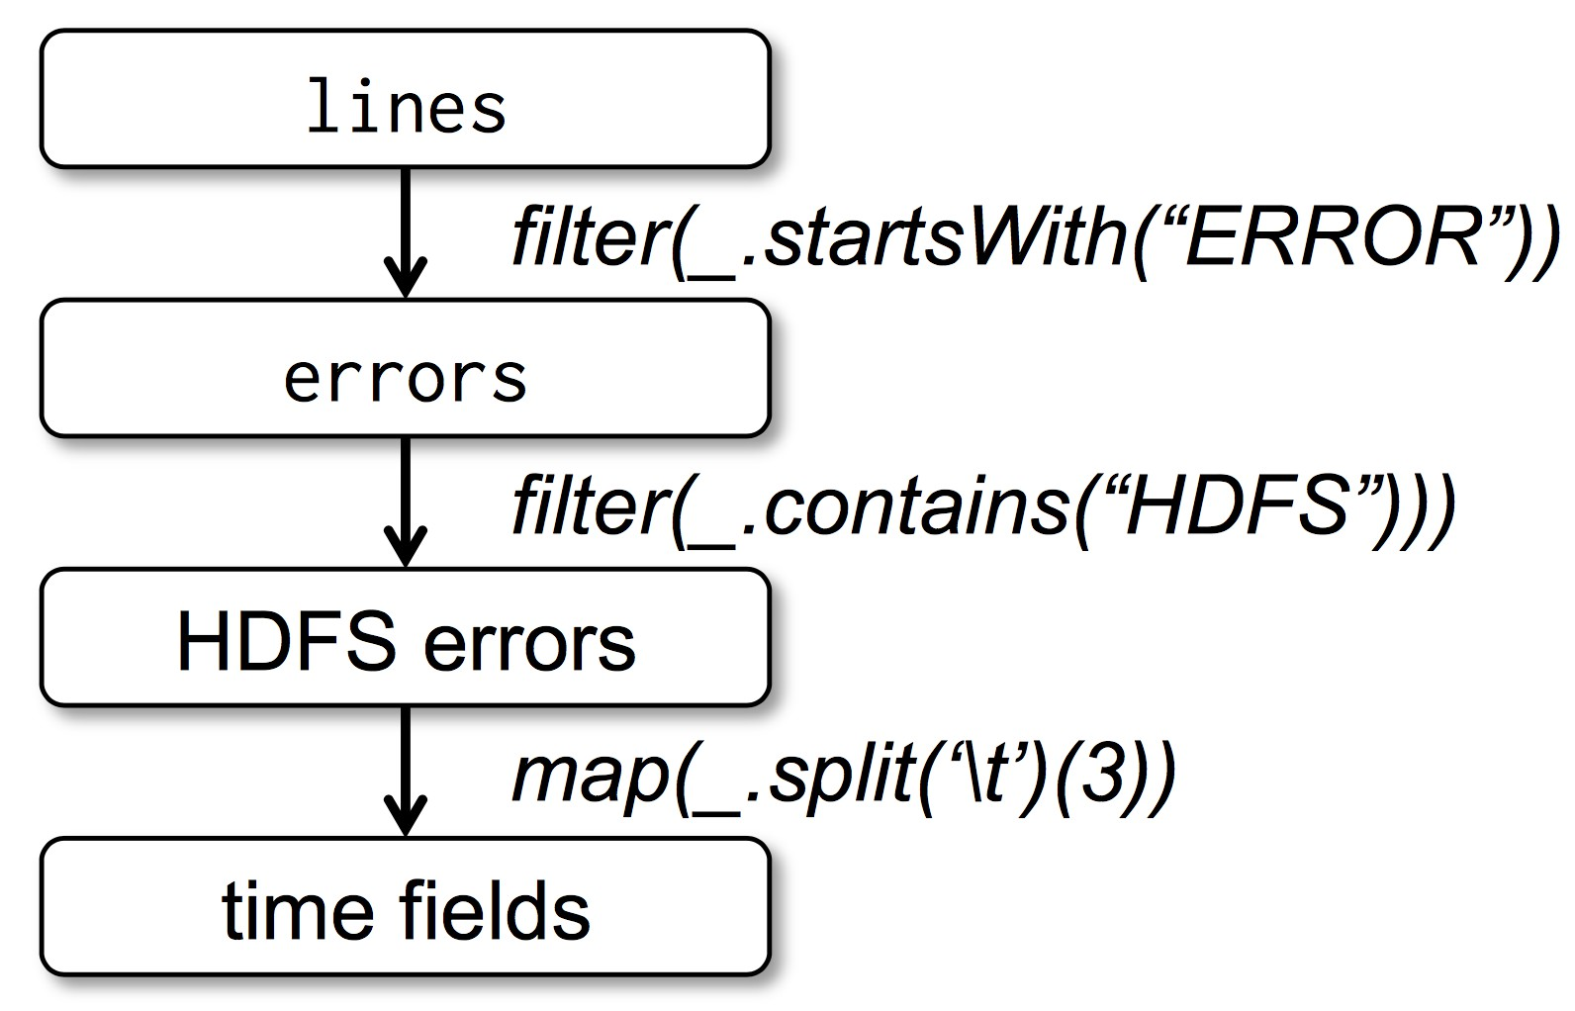
Example: Find errors in a log file
Useful core methods:
filter()
collect(), collectAsList()
map(), flatMap()
reduceByKey()
Distributed
Example
lines = spark.textFile("hdfs://...")
errors = lines.filter(_.startsWith("ERROR"))
hdfserrors = errors.filter(_.contains("HDFS"))
.map(_.split(’\t’)(3))
hdfserrors.collect()
textfile
flatMap
filter
join
textfile
flatMap
Notes:
Everything in Spark is developed around Resilient Distributed Datasets (RDD).
We can perform actions like count, collect, etc. and transformations like map, filter, joins, etc. on RDDs.
This example loads a text file into the RDD lines.
Then it searches for lines that start with the word ERROR (using the filter operation). The outcome of the search is stored into a new RDD named errors.
Then, it splits the error lines using the tab delimiter, and gets the third element.
Finally it collects the result into a list, bringing it to the driver.
collect() and collectAsList() are action operation that is used to retrieve all the elements of the RDD/DataFrame/Dataset (from all nodes) to the driver node. collect() action function is used to retrieve all elements from the dataset as a Array[Row] to the driver program. This is usually useful after a filter or other operation that returns a sufficiently small subset of the data.
collectAsList() action function is similar to collect() but it returns Java util list.
Notice here, that the filter and map operations are transformations, whereas collect is an action because it forces the driver to collect the data which are spread across the partitions into a single list.
Map() operation applies to each element of an RDD and it returns the result as new RDD. In the Map, the operation developer can define his own custom business logic.
FlatMap() is similar to Map, but FlatMap allows returning 0, 1 or more elements from map function. The collections of elements are merged into a flat non-hierarchical dataset
Map: 1 to 1
FlatMap: 1 to N
reduceByKey takes as input (key, value) pairs and automatically groups based on the key. Then, it applies the aggregate operation mentioned in the parenthesis (in this case it is the sum).
While performing these operations, Spark also keeps the lineage graph with the transformations that are being performed over the RDDs.

Slide 47
Dataflow and RDDs in Spark(2)
Word-count example: compute frequency of each word in text
Actions & Transformations on RDDs fully parallelizable
Shuffling & Synchronization required for moving data
Store intermediate data in memory, pipeline RDD transformations
Stage 0
Stage 1
3 nodes - different colors
textfile
flatMap
map
reduce
ByKey
SHUFFLE
read lines
of text file
break line into words
get (“word”,1)
key-value pairs
sum up 1s
for each word
Notes:
In the previous example, the computation did not require any coordination across the worker nodes. Each node read and filtered their own split individually. However, many computations need data movement.
One such example is the word-count, which we saw earlier in MapReduce. The goal is to compute the frequency of each word in the text.
To implement the word-count, assuming that the rdd containing the dataset is split across 3 nodes, the flatMap operation can split the lines into words (so one line can be mapped to more values If it contains multiple words).
Then, the map operation will map each word into a tuple consisting of the (key, value) pair (word,1) for each word and finally, the reduceByKey operation will group based on the word (key) and will sum the values (the 1s) and will output the final count for each word.
However, groups are splits across nodes so they need to be brought together. So, this needs to happen right before reduceByKey
Shuffling is a process of redistributing data across partitions (aka repartitioning) that may or may not cause moving data across JVM processes or even over the wire (between executors on separate machines). Shuffling is the process of data transfer between stages. By default, shuffling doesn’t change the number of partitions, but their content.
RDD is created by loading a file from HDFS, or reading a file in local storage. Spark has no control over what bits of data are distributed in which partitions.
The data is read and partitioned in an RDD, and when an “action” function is called, Spark sends out tasks to the worker nodes. If the action is a reduction, data shuffling takes place.
This becomes a problem for key-value RDDs: these often require knowing where occurrences of a particular key are, for instance to perform a join. If the key can occur anywhere in the RDD, we have to look through every partition to find the key.

Slide 48
Lazy Evaluation
First construct DAG, then evaluate whatever an action requires
Use static rule-based optimizations
Lazy evaluation permits optimizations
Compute only necessary values to reduce driver-cluster communication
Only process the required data, on-demand (model can support infinite structures such as streams)
Reduce number of queries
Pipeline intermediate results between transformations
textfile
flatMap
filter
filter
map
reduce
textfile
flatMap
join
SELECT Country, Count(*) FROM LogEntry GROUP BY Country
Notes:
RDD transformations construct the DAG which expresses what needs to be executed, however execution does not happen blindly.
RDDs optimize the physical plan to execute computations efficiently. They allow using different static rule-based optimizations, reduction of materialization, etc. This step is similar to query optimization.
The DAG can only be optimized after all operations are known.
The idea is to first compute the DAG and evaluate it in the end.
Expressions are also evaluated only when necessary. Spark triggers the execution only when an action is performed. Therefore in the previous example (finding errors in a file), if there was no collect operation, nothing would have been executed. In this slide’s example, if we have a DAG in which some nodes don’t lead to an action, we only compute the nodes that affect the actions and discard the rest.
Lazy evaluation:
Improves manageability: Users can organize their Apache Spark program into smaller operations, and Spark reduces the number of passes on data by grouping operations.
Saves computation and improves speed: Lazy Evaluation plays a key role in saving calculation overhead. Since only necessary values get computed, this saves the trip between driver and cluster, thus speeds up the process.
Reduces overhead: The two main overhead of any operation are time and space; Apache Spark's lazy evaluation addresses both issues. As action is triggered only when the data is required, it saves time and space because we do not execute every operation.
Optimization: It reduces the number of queries.
Hence, Lazy evaluation enhances the power of Apache Spark by reducing the execution time of the RDD operations. It maintains the lineage graph to remember the operations on RDD. As a result, it optimizes performance and achieves fault tolerance.

Slide 49
Limitations of vanilla Spark
RDDs are schema-less
Inefficient: think of accessing raw text files
Expensive: high space overhead
Important optimizations not supported!
Access a single column: parsing to find position
Query plan is hand-optimized
Queries cannot refer to attributes
Think of implementing SQL capabilities
Notes:
The main issue of RDDs is that they do not have schema information. This is both inefficient and expensive.
Spark RDDs are stored as objects, which contain metadata. Their memory footprint can be more than an order of magnitude larger than the same data stored in columnar format.
What’s worse, accessing few columns, for example a single column in a query, results in accessing all objects in the best case, if the data is cached, or parses again the raw data in the worst case.
Spark RDDs support some static optimization rules, however the query plan is mostly hand-written. There is no query optimizer to choose the join order or apply other optimizations that are common in SQL databases.
Another problem is that we cannot write queries that refer to attributes, for example sailor.age. RDD is a collection of objects so RDD operations access object members instead. We cannot simply write “age < 20”, we have to implement a lambda for this filter. We cannot simply write “age < 20”, we have to implement a lambda for this filter so the syntax is using a lambda to check the filter (row[2] < 20), which hurts programmability and is error-prone (coding error, type errors, etc).
So, if our queries simply require filters, maps, aggregation, averages, sum, then RDDs make programming more complex than SQL. [1]
Spark SQL conveniently blurs the lines between RDDs and relational tables. Unifying these powerful abstractions makes it easy for developers to intermix SQL commands querying external data with complex analytics, all within in a single application. Furthermore, by relying on SQL, the developers reclaim schema information and can use query optimization techniques.

Slide 50
Summary
Dataflow is more expressive than MapReduce
Distributed memory abstraction eliminates redundant I/O in MapReduce
Lazy evaluation permits some optimizations, but misses critical SQL features

Slide 51
Overview
Distributed Query Processing
MapReduce model
Dataflow model in Spark
Optimizing Large-scale Processing

Slide 52

Plan of attack
Add schema to RDDs
Space-efficient data representation
Computationally-efficient access to individual attributes
Offer an extensible SQL-like language
Easier to express queries
SQL-like optimizations on data accesses
Result:
SQL
Notes:
DataFrame is a distributed collection of data ordered into named columns. You might remember a table in relational database. Spark DataFrame is similar to that.
Dataframes are RDDs with schema information which allows efficient access of the attributes of the dataset.
Using this approach it is easier for a user to express queries over the rdds, and allows for SQL optimizations, such as columnar storage and caches.
Spark SQL offers much tighter integration between relational and procedural processing compared to DBMS, through a declarative API that integrates
with procedural Spark code.
Second, by using a declarative language, it allows for a highly extensible optimizer, based on the features of the Scala programming
language, that makes it easy to add composable rules, control code generation, and define extension points.

Slide 53
Data model
Nested data model
Supports all primitive SQL types (boolean, integer, string, …)
Supports complex types (structs, arrays, maps, unions)
User-defined types
Complex data types are first-class citizens
Notes:
Spark SQL uses a nested data model based on Hive for tables and DataFrames. (Hive is an ETL and data warehouse tool on top of Hadoop ecosystem and used for processing structured and semi structured data.)
This data model is more expressive than purely relational data in traditional SQL systems and is crucial for applications that process rich data formats.
SparkSQL supports all major SQL data types, including boolean, integer, double, decimal, string, date, and timestamp, as well as complex (i.e., non-atomic) data types: structs, arrays, maps and unions. Complex data types can also be nested together to create more powerful types.. In addition, Spark SQL also supports user-defined types.
Unlike many traditional DBMSes, Spark SQL provides first-class support for complex data types in the query language and the API.

Slide 54
Key notion: Data frames
Unstructured RDD
Data frame
John, 20, Developer
Marissa, 63, Manager
Bill,61, Owner
Jack,21, Developer
…
name | age | role
John | 20 | Developer
Maria | 63 | Manager
Bill | 61 | Owner
Jack | 21 | Developer
… | … | …
createDataFrame(…)
Columnar
representation
Notes:
A dataframe is an rdd with schema information.
For example, the RDD on the left-hand-side is basically a parsed CSV, there are no column names and specific structure that. The tuples are stored as objects and offer only array-like access to fields.
Also, the rows are stored as Java objects, which incurs an additional memory footprint, and not in an efficient storage layout, such as columnar.
DataFrames are collections of structured records that can be manipulated using Spark’s procedural API, or using new relational APIs that allow richer optimizations.
(animation continues)

Slide 55
Unstructured RDD
Data frame
John, 20, Developer
Marissa, 63, Manager
Bill,61, Owner
Jack,21, Developer
…
name | age | role
John | 20 | Developer
Maria | 63 | Manager
Bill | 61 | Owner
Jack | 21 | Developer
… | … | …
createDataFrame(…)
Data frames created from
RDDs
Manipulation of other data frames
Other data sources
relational dbs, csv files, …
can utilize capabilities of the data source, e.g., filtering
Columnar
representation
Notes:
DataFrames can be created directly from Spark’s built-in distributed collections of Java/Python objects, enabling relational processing in existing Spark programs.
Like RDDs, operations on dataframes create new dataframes that can then be used in turn.
Another option for creating Dataframes is connectors. Connectors are interfaces to data sources (e.g. external files, databases, other distributed systems) and allow frameworks to read dataframes from other sources. This feature enables developers to set up complex data pipelines across systems. Some connectors enhance performance by exposing the capabilities of the data source e.g. filter pushdown inside a database will significantly reduce extracted and transferred data

Slide 56
DataFrame operators
Relational operations via a Domain Specific Language
Input: expression
Output: an abstract syntax tree (AST)
Two choices for writing queries
Chaining operators: compute a sequence of intermediate Dataframes
Use traditional SQL
extensible with User Defined Functions (UDFs)
Catalyst optimizer transforms AST to query plan
Notes:
Users can perform relational operations on DataFrames using a domain-specific language (DSL) similar to R data frames and Python Pandas. The DSL of
DataFrames supports all common relational operators from SQL, including projection (select), filter (where), join, and aggregations (groupBy). These operators all take expression objects in a limited DSL (for example a filter takes a an object that represents the predicate expression)
Queries can be written in two ways:
one is to chain operators by computing a sequence of dataframes. This is similar to programming with RDDs For example, tmp1 <- select(table1), tmp2 <= tmp1.join(table2) …
the second approach is to write SQL. Dataframe SQL is not pure SQL, however. It is extensible as it supports User Defined Functions
After the query is complete, the produced AST is converted into a query plan using the Catalyst optimizer

Slide 57
Optimization principles
Declarative language to express user’s information needs
Write less code: let the optimizer do the hard work
Lazy evaluation: holistic optimization
Get ALL operations and optimize them as one query
Code generation to avoid interpretation overhead
Notes:
The main characteristic of sparkSQL is that it offers a declarative language similar to SQL to allow users easily express their operations and then it can optimize the operation using an extensible optimizer.
So, unlike RDDs, which are often hand-optimized, SparkSQL provides the user with a declarative interface, in which they only need to provide what they want. The optimizer will decide how.
Based on the RDDs idea, it uses lazy evaluation to holistically optimize the whole task. Each RDD represents a “logical plan” to compute a dataset, but Spark waits until certain output operations, such as count, to launch a computation. This allows the engine to do some simple query optimization, such as pipelining operations. For instance, Spark can pipeline reading lines from the HDFS file with applying a filter on the lines and computing a running count, so that it never needs to materialize the intermediate lines and output results.
While such optimization is useful as we discussed earlier, it is also limited because the engine does not understand the structure of the data in RDDs (which is arbitrary Java/Python objects) or the semantics of user functions (which contain arbitrary code).
The final phase of query optimization is query compilation which involves generating Java bytecode to run on each machine. Because Spark SQL often operates on in-memory datasets, where processing is CPU-bound, it supports code generation to speed up execution, and avoid interpretation overhead.

Slide 58
Advantages of model over SQL
Easier, more flexible language
Easy to add control structures (e.g., if, for, …)
More intuitive to perform complex operations
Holistic optimization across functions composed in different languages
Notes:
While the popularity of relational systems shows that users often prefer writing declarative queries, the relational approach is insufficient for many big data applications.
First, users want to perform ETL to and from various data sources that might be semi-or unstructured, requiring custom code.
Second, users want to perform advanced analytics, such as machine learning and graph processing, that are challenging to express in relational systems. In practice, we have observed that most data pipelines would ideally be expressed with a combination of both relational queries and complex procedural algorithms. Unfortunately, these two classes of systems—relational and procedural—have until now remained largely disjoint, forcing users to choose one paradigm or the other.
Spark SQL bridges the gap between the two by providing an easier and more flexible language and allows for the execution of complex operations.
Third, it allows for holistic optimization using Catalyst optimizer.

Slide 59
Summary
Dataframes extend dataflow with a) schema, and b) SQL-like language
Best of both worlds:
flexibility: complex data models and types, UDFs
declarative programming
Notes:
To conclude, Dataframes enhance the dataflow model by extending it with a schema and wrapping it with an SQL-like language. In the background, however, it is still a dataflow program running.
Spark and other “big data” frameworks have been successful because of the flexibility they offer. Dataframes preserve the flexibility, offering complex types and udfs, but also provide declarative programming which is crucial for performance and for programmability, as it hides performance optimizations.

Slide 60
Conclusions
Distribution is necessary for scalability!
Complexity of distributed execution need not be exposed to developer
Programming model is important for both expressibility and performance

